Slide 1
Programming and automated signal analysis
Ilse Jonkers
Wouter Aerts, Maarten Afschrift,
Jozefien Burg, Lianne Zevenbergen

Slide 2
Matlab Practical Session 4
Flow control

Slide 3
Exercise 1: BMI

Slide 4
Exercise 1: BMI

Slide 5
Exercise 2: Kinematics

Slide 6
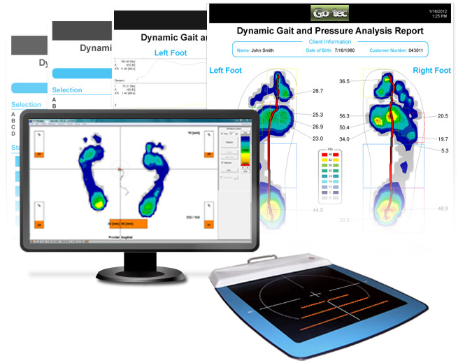
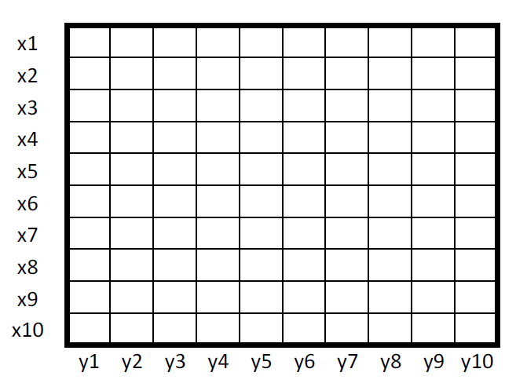
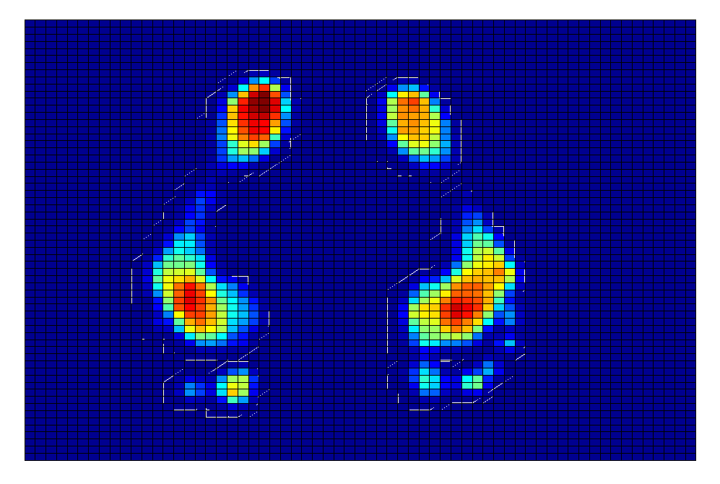
Exercise 3: Plantar pressure
Δy
Δx

Slide 7
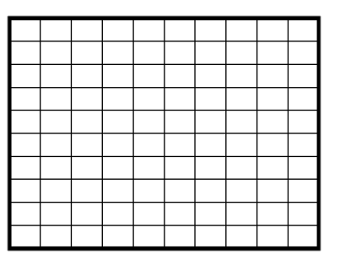
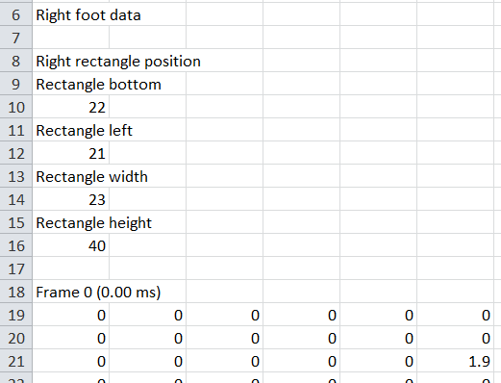
Exercise 3: Plantar pressure
Frame 1
Frame 2
Frame 3
Frame 4
Frame 5
Frame 6
Frame 7
Frame 8
Y dimension
Frame dimension
X dimension

Slide 8
Exercise 4: Ages

Slide 9
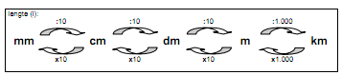
Exercise 5: Metric unit converter

